Slide 1
Models of Option Pricing
Tim Youell
100086041
School of Computing Sciences
Supervisor: Dr Chris Greenman
Notes:
Models of Option Pricing
Hello, I’m Tim and this is my project proposal on the Modelling of Option Pricing, my superviser is Dr Chris Greenman and he’ll be advising me through this project.

Slide 2
Basic Overview
Introduction to the Project
Project aims
Purpose of the study
Previous Research
Methodology
Phases
Project Plan
Risks
Gantt Chart
Notes:
Basic Overview
Read off the slide.

Slide 3
Options
A contract that grants the buyer the right, but not the obligation to purchase or sell financial assets, such as shares.
Puts = obligation to sell
Calls = obligation to buy
Used to magnify financial gain.
European – cannot be exercised until the exercise date.
Notes:
Options
You may or may not have heard of financial options before, but options are financial derivatives used by traders to speculate the risk of holding or selling an asset to magnify financial gain. The contract grants the buyer the right, but not the obligation to purchase or sell financial assets, subject to predetermined conditions such as an agreed on price, known as a strike price, within a specified period of time. In regards to the exercise date, there are two main types of options: European options can only be exercised on the settled date. European options are the only type that can be used with the Black-Scholes model, the main model in my project, which will be discussed in the next few slides. American options can be exercised at any point up until and on the exercise date.

Slide 4
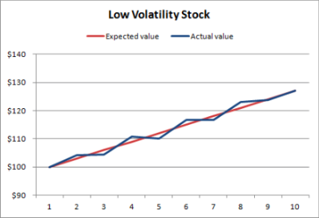
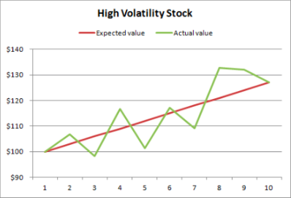
The Modeling of Options
Calculate theoretical option values
Fixed knowns: underlying price, time until expiration, strike price.
Assumptions: Volatility
Notes:
The Modeling of Options
So why am I studying the modeling of option prices? What can their modeling tell us?
Using the following fixed knowns and forecasting values such as those that you see here, options can be used to calculated theoretical option values.
The overall aim is for traders to mitigate risk, to maximize financial gain.
For instance, you are more likely to make more money on a stock with higher volatility and hence a higher volatility contributes to a higher options price.

Slide 5
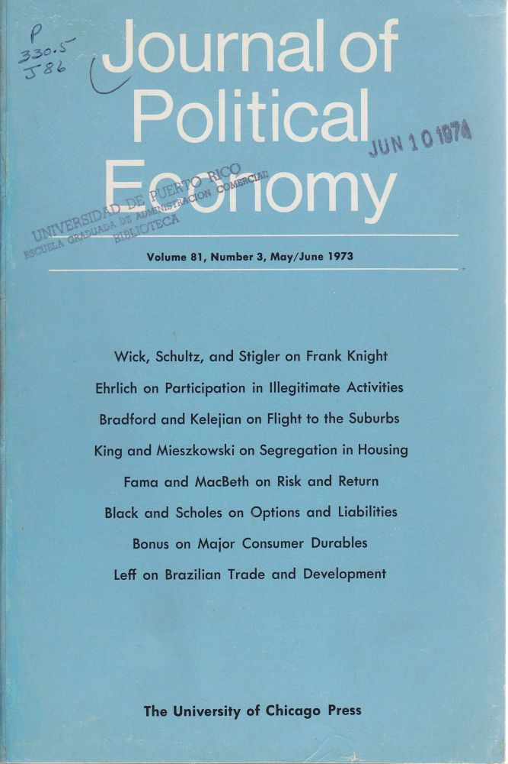
The Black-Scholes Equation
Options have been used for thousands of years.
Revolutionised in 1973 in the report by Fischer Black and Myron Scholes: “The Pricing of Options and Corporate Liabilities”.
Saw options being used as securities and financial derivatives for the first time.
Black, F. Scholes, M. (1973). The pricing of corporate liabilities. Journal of Political Economy, 81(3):637-654.
Notes:
The Black-Scholes Equation
Believed to have originated in Ancient Greece, options were first used by olive traders who became unwilling to accept the amount of risk for a low price for their crop.
A major timeline point in the pricing of options and the start of their use as a financial derivative came about in 1973 when Fischer Black and Myron Scholes and extended by Robert Myron in the report
“The pricing of options and corporate liabilities”. Now lets see how it works.

Slide 6
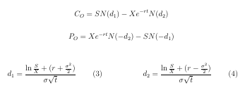
The Black-Scholes Pricing Formula
Five input variables are required:
The current stock price (S)
The exercise price of an option (X)
The risk-free rate (r)
The time to expiration (t)
The volatility (σ)
Notes:
The Black-Scholes Pricing Formula
Extending from the Black-Scholes Partial Differential Equation, the Black-Scholes Option Pricing Formula can be shown here. The variables are shown here.
\item (N)d is the cumulative distribution function.
The idea being you plug all these known variables in and you get a theoretical option price back. The higher the volatility, the higher the option price.

Slide 7
Project Aims & Objectives
Aim: Test the limitations of Black-Scholes pricing formula.
Objectives:
Collection and testing of financial data to check its validity.
Solutions to the BS model will be compared to actual option prices.
The same tests will be carried out on different models.
Cryptocurrency data will also be explored.
Notes:
Project Aims & Objectives
There are currently mixed reviews about the use of the BS option pricing formula, with various sources saying that it is "past its time" and holds biases. The problem that this research paper is trying to solve is the testing of these accusations. The main aim of the project is to test the limitations behind the black-scholes option pricing formula to see if it still justified over other, newer models, for example: Are newer models such as Binomial, Mathematical and Runge-Kutta better equipped to todays option pricing? I’m hopefully going to find this out.
The project is broken down into the following objectives.

Slide 8
Methodology
Collect financial data
Test the financial data
Data formatted to fit as a solution to the BS pricing formula and other methods.
Solutions to the formulas compared with actual option prices.
All of the above then carried out with cryptocurrency data, is it really more volatile?
Notes:
Methodology
Finance data will then be collected probably from Yahoo! Finance.
The data will then be tested for log-normality in order to determine whether the sample has been drawn from a normally distributed population.
Formatted data will then be plugged into the pricing formulas in order to give out theoretical call and put option prices.
Solutions to these will then be compared with actual option prices with more tests such as contrasts and analysis of variance.
The same as above, carried out on cryptocurrency data instead.
Apart from the collecting, the main bulk of the procedures will be carried out in the statistical programming environment, R.

Slide 9
Project Plan – Risks
Loss of work due to computer malfunction
R/Software Failure
Difficulty finding financial data
Dissertation advisor absences
Falling behind on project due to poor time management
Struggling to learn the new coding language
Notes:
Project Plan - Risks
Onto the risks involved in my project.
Here we see some examples of some of the things that can go wrong in the project. I have suitably evaluated the risks in a likelihood vs severity matrix and come up with contingency plans for each of them. For instance, checking to see when my advisor is away and consistently backing up my work on GitHub and to external disks.

Slide 10
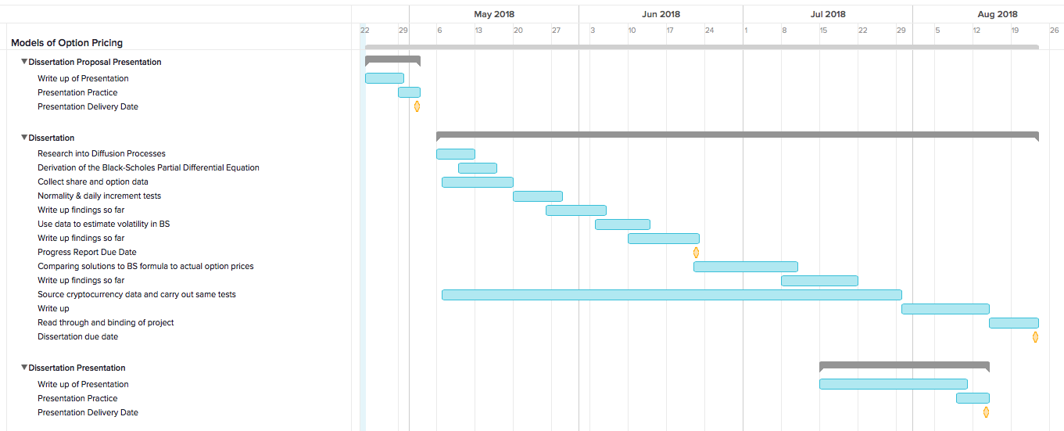
Project Plan – Gantt Chart
Notes:
Project Plan – Gantt Chart
Here we see my project work-plan, including important milestones and lengths of tasks.
Following this presentation, I will begin to gather financial data in order to test in and then formulate it. I have already outlined the key phases involved in my project in the methodology section and have included write up times, in order to keep on top of the writing of the project.

Slide 11
Previous Research
Ermogenous, A. (2005). Brownian Motion and its applications in the stock market.
Shinde, A. and Takale, K. (2012). Study of black-scholes model and its applications. Procedia Engineering, 38:270-279.
Heston, S. L. (1993). A closed-form garch option valuation model. The Review of Financial Studies, 13(3):585-625.
Melino, A. and Turnbull, S. M. (1990). Pricing foreign currency options with stochastic volatility. Journal of Econometrics, 45(1-2):239-265.
Lauterbach, B. and Shultz, P. (1990). Pricing warrants: An Emperical Study of the blackscholes model and its alternatives. The Journal of Finance, 45(4):1181-1209.
Notes:
Previous Research
Here is a slide showing some of the key literature surrounding option pricing modeling and in particular, arguments for and against the black-scholes model.

Slide 12
Any Questions?

